Slide 1
Carbon Border Adjustment Mechanism (CBAM)
What is it about? When will it come into force?
September 2023

Slide 2
EU Climate Policy
Brief scene setter

Slide 3
EU Aims at Climate Neutrality How to do it?
EU Emissions Trading Scheme (ETS)
Introduced in 2005 and developed stepwise over the years
Cornerstone of the EU's policy to combat climate change – approx. 40% of EU GHG emissions
Covers large industrial and electricity plants
Carbon leakage addressed via free allocation of emission allowances
Sectors outside EU ETS
Buildings, transport, small industries, agriculture – approx. 60% of EU GHG emissions
Member States national measures
8 Member States (e.g. Sweden) have national carbon taxes
EU climate goals, decided in 2019
Political ambition is a legal obligation for the EU (EU Climate Law)
First climate-neutral continent in 2050
Reduce carbon emissions by 55% in 2030
EU Green Deal, presented in 2019
Fit for 55 Package legislative proposals in 2021, such as
Review of the EU ETS – tightened, extended to other sectors
Free allocation is phased out
Prevent carbon leakage to ensure effectiveness of EU climate policy = CBAM is introduced
CBAM is an essential part of EU Climate Policy, not a protectionist measure.

Slide 4
CBAM
Global context

Slide 5
Why is There a Need for CBAM?
Global climate challenge requires urgent action – time for action is now!
Paris Agreement; recent IPCC report
EU raises its climate ambition
Differences in climate ambition among EU’s trading partners => CBAM prevents carbon leakage to ensure effectiveness of EU climate policy on the EU market
Incentivise ….
3rd country producers to reduce emissions
3rd countries to adopt green policy frameworks

Slide 6
CBAM or International Coordination?
CBAM has a strict climate objective
CBAM favours decarbonisation efforts in third countries
Deduction of explicit carbon price paid in 3rd countries from CBAM obligation
Actual emissions methodology
Countries linked to EU ETS will be excluded
Possible international agreements on how to take account of carbon price
CBAM does not preclude continued joint work on international coordination of carbon pricing

Slide 7
CBAM
EU legal adoption process

Slide 8
When Will We Know All the Details? I
CBAM Regulation – major framework
December 2022 Political agreement between EU co-legislators (https://data.consilium.europa.eu/doc/document/ST-16060-2022-INIT/en/pdf
Spring 2023 Formal adoption by EU co-legislators
19 April European Parliament vote
25 April EU Council vote
10 May Formal signing ceremony by co-legislators
16 May Publication in OJ L 130/52 Publications Office (europa.eu)
1 October 2023: Transitional period starts - reporting
1 January 2026 : Definitive period starts – financial obligation; EU imports only by authorized CBAM declarants

Slide 9
When Will We Know All the Details? II
Secondary legislation – supplement framework
Adopted by EU Commission based on empowerments in CBAM Regulation, prepared by CBAM Committee (Member States Representatives) and stakeholder views
12 implementing acts, to ensure detailed uniform application
One on methods for reporting during transitional period; adopted 16 August 2023, link to implementing act;
11 others (sufficiently prior to 1 January 2026)
4 delegated acts – reflect certain developments
E.g. circumvention, adding countries to list of countries excluded from CBAM fulfilling certain criteria, such as linking to EU ETS

Slide 10
CBAM
Challenges when designing CBAM

Slide 11
Specific considerations during EU deliberations…..
Which sectors and which specific goods?
Direct emissions as well as indirect emissions?
Calculation method of actual emissions in line with EU ETS
EU ETS installations vs CBAM goods
WTO conformity
Trajectory for phasing in of CBAM and phasing out of free allowances under the EU ETS
Export carbon leakage
Governance model

Slide 12
CBAM Regulation – changes between EU Commission July 2021 proposal and Final Agreement between EU co-legislators)
Major changes:
Delay of entry into force to 1 October 2023.
Some additional goods added to CBAM scope
Indirect emissions in some goods added to financial CBAM obligation
Some changes of pace of phase in of CBAM obligation
Extended review clauses
Small consignments of goods excluded (150 €)
Governance – more centralised tasks at EU Commission, less on national EU authorities

Slide 13
CBAM
A closer look at the design

Slide 14
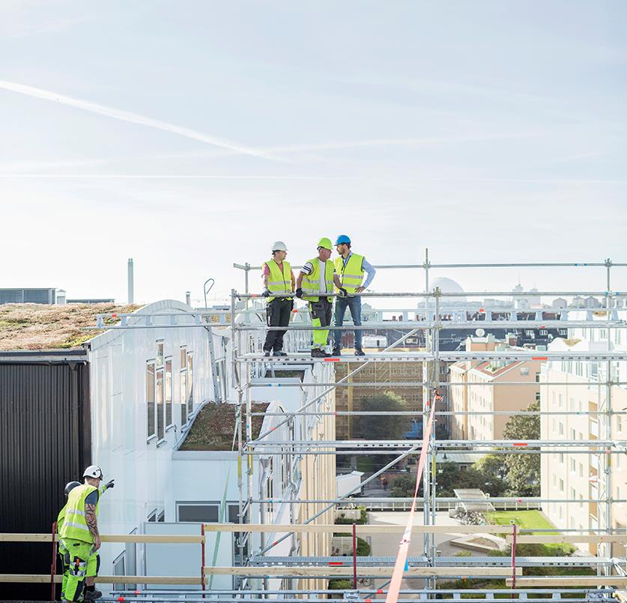
CBAM Design Key Elements
Addressed to companies, not countries
Based on actual verified carbon emissions embedded in imported goods
Focus on goods in carbon intensive sectors
A Regulation mirroring EU ETS carbon pricing to the extent possible
Obligations on EU importers
Not a tax; not a customs duty
Climate objective
Compliant with WTO and in line with international trade rules
Photo: Maskot / Folio

Slide 15
Goods in CBAM Scope General Basics
Selected on basis of three criteria
High risk of carbon leakage (high carbon emissions; high level of trade)
Covering major part of carbon emissions under EU ETS
Practical feasibility to calculate embedded emissions in goods
First phase
Goods within limited number of sectors
Goods defined by CN codes
Further stages, following review post 2025
Extending to other sectors under EU ETS
Photo: Folio Images

Slide 16
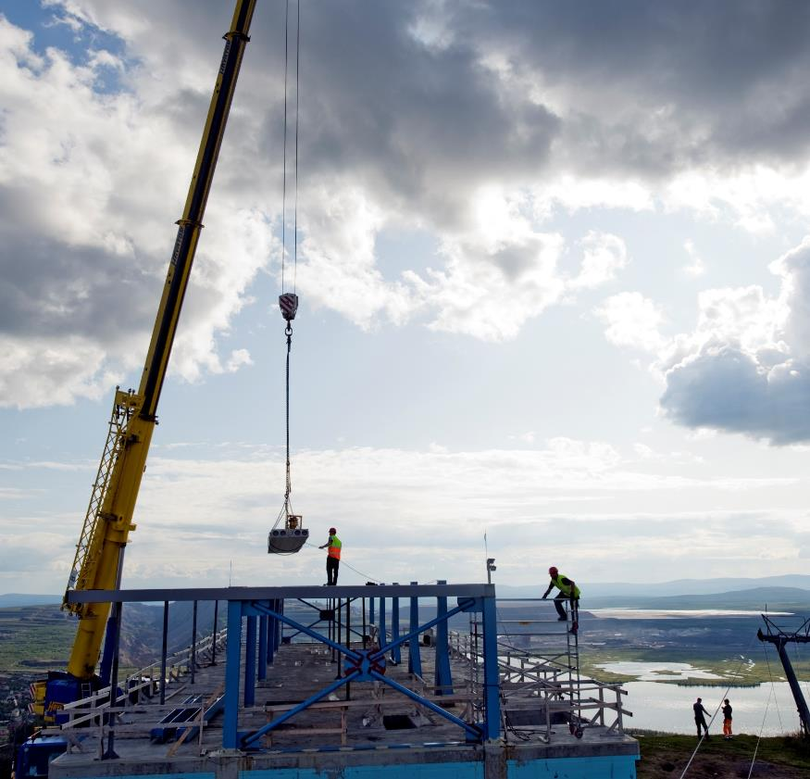
Goods in CBAM Scope Specific (Final Agreement)
Goods in the following sectors:
Iron & Steel, incl. some precursors
Aluminium
Cement
Fertilisers
Electricity
Hydrogen
Direct and indirect emissions:
Transitional period 2023-2025, reporting on actual direct as well as indirect emissions
Final period from 2026, declaring
Electricity: By default values, possibility to show actual verified direct emissions
For other goods, two groups of goods:
Group 1: Actual verified direct emissions; alt. use of default values (incl. mark-ups)
Group 2: Group 1 + indirect emissions (default values)
Photo: Lars Thulin / Johnér

Slide 17
Carbon Price, from 1 January 2026
Equal carbon pricing
EU companies pay a carbon price via EU ETS on goods produced in the EU
Importers pay a carbon price, corresponding to the EU ETS price
The CBAM obligation only applies if EU ETS free allowances has been phased out
Gradual phase in of CBAM obligation
Mirroring the phase out of EU ETS free allowances
COM proposal: 2026-2035 Linear 10% annual phase in
Political agreement dec 2022: 2026-2034, but slower pace from start
No double pricing
An explicit carbon price paid in a 3rd country for the embedded emissions in imported goods will be deducted from the CBAM obligation

Slide 18
How is Carbon Price Paid in 3rd Country Determined?
Explicit carbon price (Art. 3 (23) of CBAM Regulation)
’monetary amount paid in a third country, under a carbon emissions reduction scheme, either in the form of a tax, levy, fee or emission allowances under a greenhouse gas emissions trading system, calculated on greenhouse gases covered by such a measure, and released during the production of goods’
In line with WTO rules, mirrors EU carbon pricing
Photo: Folio Images

Slide 19
CBAM
CBAM obligations on EU importers
from 1 October 2023 vs from 1 January 2026

Slide 20
What Happens During the Transitional Period? (1 October 2023 – 31 December 2025)
The Customs Declarant (the importer) reports embedded direct and indirect emissions
CBAM goods imported to the EU from 1 October 2023
Report by each quarter; first report at latest by 31 January 2024
No verification of emissions
‘Effective, proportionate and dissuasive’ penalty by national CBAM Authority on importer if not complying
Methodology and criteria for penalty in implementing act
Reports submitted to EU Commission via the transitional registry
To gather data for forthcoming implementing acts for definitive period
‘Learning by doing’ period for business
Photo: Folio Images

Slide 21
Obligations on Importers in Definitive Period I (from 1 January 2026)
Goods can only be imported to the EU by an authorised CBAM declarant
Importer has to be established in an EU Member State
Authorisation by the CBAM Authority in the Member State of establishment, demonstrating financial and operational capacity
Application possible from 31 December 2024
Yearly declaration of CBAM imports during previous calendar year
By 31 May 2027 submit CBAM declaration for imports during 2026
Specifying embedded emissions according to laid down methodology,
Ensuring that declared emissions are verified by an accredited verifier and include relevant verification reports
Calculating CBAM certificates to be surrendered
By 31 May surrender CBAM certificates covering declared emissions
Reviews of declarations by EU Commission and CBAM Authorities; non-compliance results in penalties
Photo: Thyra Brandt / Folio

Slide 22
Obligations on Importers in Definitive Period II (from 1 January 2026)
Purchase of CBAM certificates
1 CBAM certificate equals 1 ton of embedded emissions in goods
Authorised CBAM declarants buy at common EU auction platform
Price = average weekly price of EU ETS allowances
Upon purchase, CBAM certificates are registered in account of authorised CBAM declarant in CBAM Registry
No trading allowed between authorised CBAM declarants
An authorised CBAM declarant must ensure CBAM certificates for 80% of embedded emissions in his account by end of each quarter
Non-compliance may lead to revoking status of authorised CBAM declarant
Limited possibility to re-sell surplus CBAM certificates to the EU COM.
Ensure that an accredited verifier will verify the embedded emissions
Use person accredited as EU ETS verifier, or
A person may seek authorisation by an EU Accreditation Body as an CBAM verifier.
Photo: Folio Images

Slide 23
Role of a 3rd Country Producers
All legal CBAM obligations on the EU importer, not on 3rd country producer, but ….
• The EU importer is obliged to give detailed info on
embedded emissions in the imported goods
• Access to data from the 3rd country producers
needed for imports from 1 October 2023; from 1
January 2026 these data verification by an
accredited verifier.
A 3rd country producer may register contact information and activity in EU CBAM Registry
To facilitate contacts between importers and 3rd country producers; possible already from 1 Oct. 2023
The 3rd country producer shall ensure verification of embedded emissions.
Photo: Johnér Images

Slide 24
CBAM – Questions?
Contact information:
Susanne Åkerfeldt
Senior Adviser
Tax and Customs Department
Ministry of Finance, Sweden
E-mail: susanne.akerfeldt@gov.se
Phone: +46 8 405 1382
Oliver Sparrings
Legal Adviser
Tax and Customs Department
Ministry of finance
E-mail: oliver.sparrings@gov.se
Phone: +46 8 405 3901
Photo: Folio Images

